Slide 1







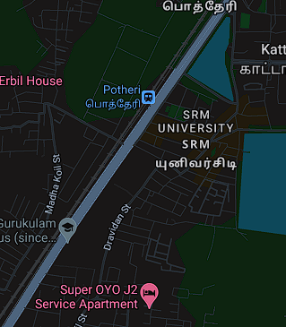

Mind Benders
STAYFINDR
Problem Statement: STAYFINDR addresses the challenge of college students needing a centralized platform to find campus services, local businesses, accommodations, and transportation options efficiently.
Track: Conduct market research and define core features; design and develop the website with a focus on user experience; launch with targeted marketing; and continuously update based on user feedback and performance metrics.
Team Name : Mind Benders
STAYFINDR📍

Slide 2

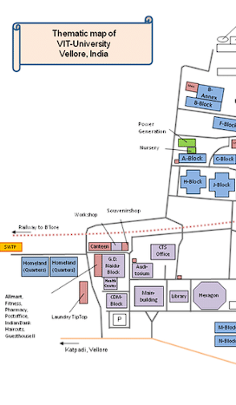
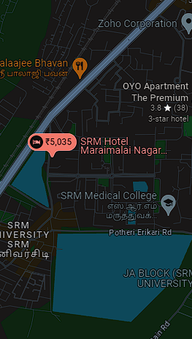
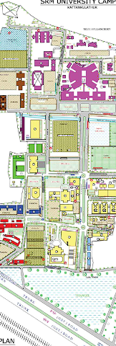
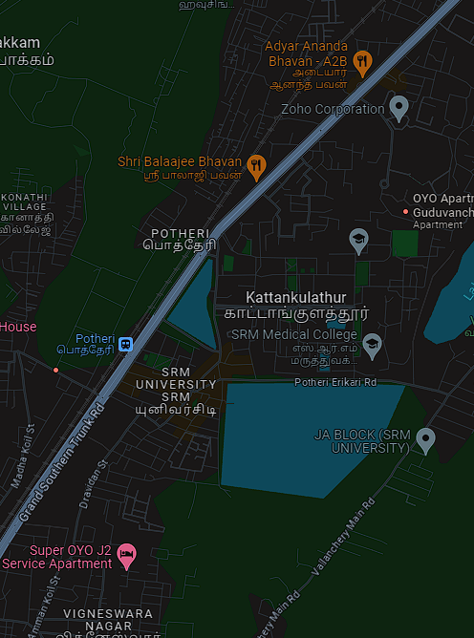

Mind Benders
College and Campus Information
Campus Map: Interactive map highlighting important locations such as libraries, cafeterias, dorms, and administrative offices.
Campus Services: Details on on-campus services like health centers, counseling, and career services.
Off Campus: Services and deatils that includes entertainment and other modes of enjoyments.
STAYFINDR📍

Slide 3







Mind Benders
Transportation Information
Public Transport: Information on nearby bus stops, local train stations, and subway lines with schedules and routes.
Ride-Sharing Options: Integration with ride-sharing services or listings for local taxi services.
Shuttle services: Details on In campus shuttle services provided by the colleges.
Renting: Details on renting a vehicle of your choice.
STAYFINDR📍

Slide 4

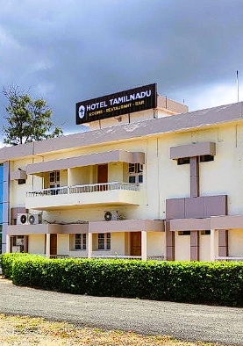
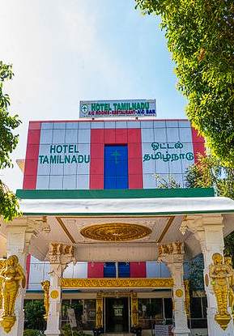

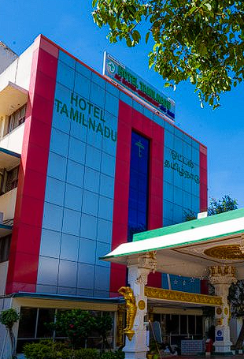


Mind Benders
Accommodation Finder
Hotels and PGs: Searchable database of nearby hotels and Paying Guest (PG) accommodations with filters for price, amenities, and detailed reviews with ratings.
Room Rentals: Option for landlords to list available rooms and students to find roommates for the same.
STAYFINDR📍

Slide 5






Mind Benders
Local Services and Businesses
Service Directory: Listings of nearby services such as banks, grocery stores and gyms.
Shopkeeper Listings: Space for local shopkeepers to list their businesses and special offers.
Student Marketplace: A section where students can buy and sell items like textbooks, electronics, and clothing.
STAYFINDR📍

Slide 6






Mind Benders
Additional Features
Events Calendar: Local events, student activities, and community happenings.
Reviews and Ratings: User reviews for services, accommodations, and businesses.
Student Resources: Links to academic resources, study groups, and tutoring services
Business Model
Monetization: Options include advertising, premium listings, transaction fees, or subscription models.
Revenue Streams: Fees from businesses and landlords, premium services for users.
STAYFINDR📍

Slide 7
Thank You ~Mind Benders

